Slide 1
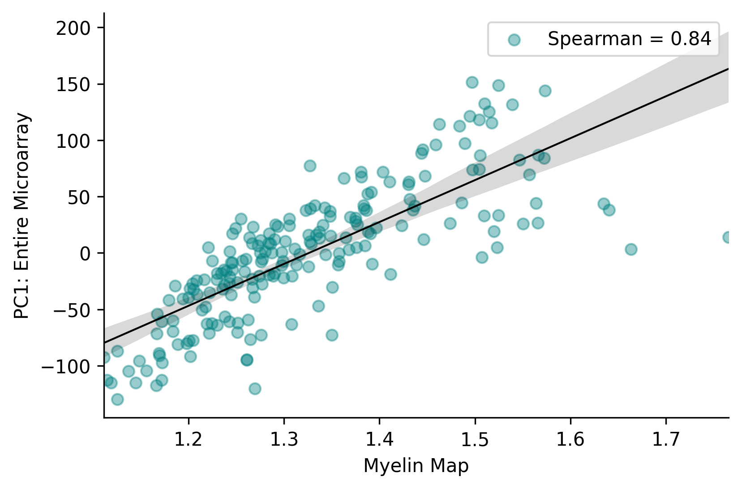
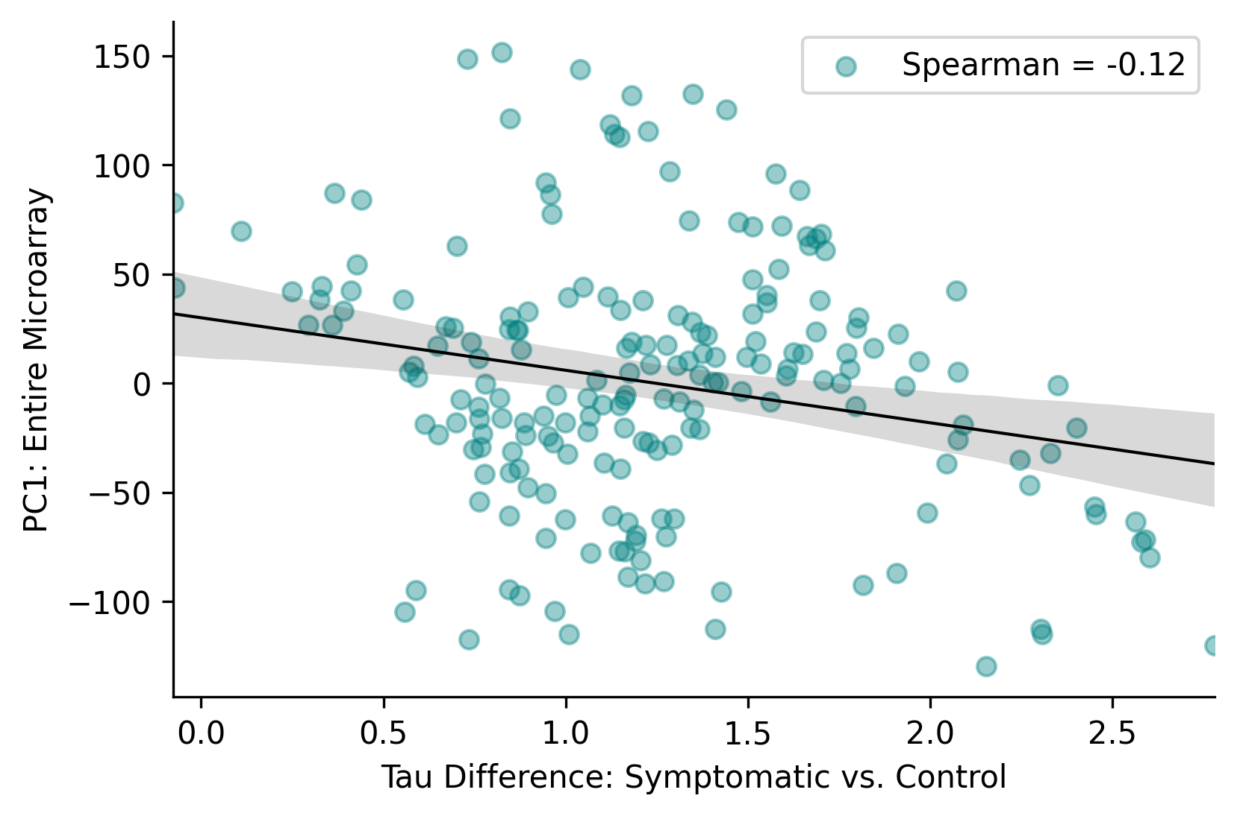
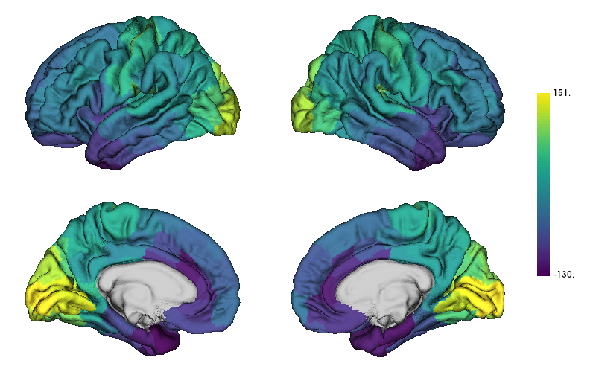
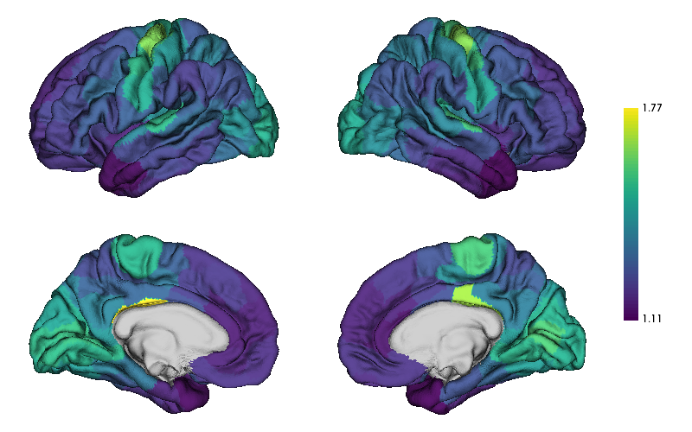
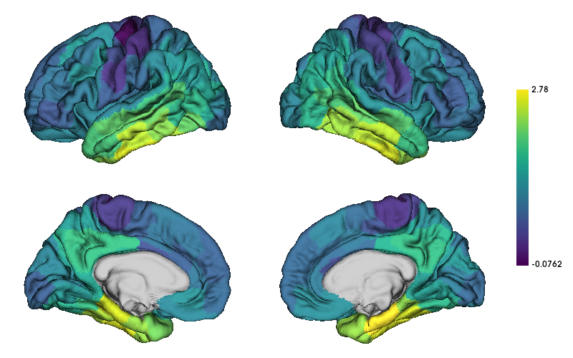
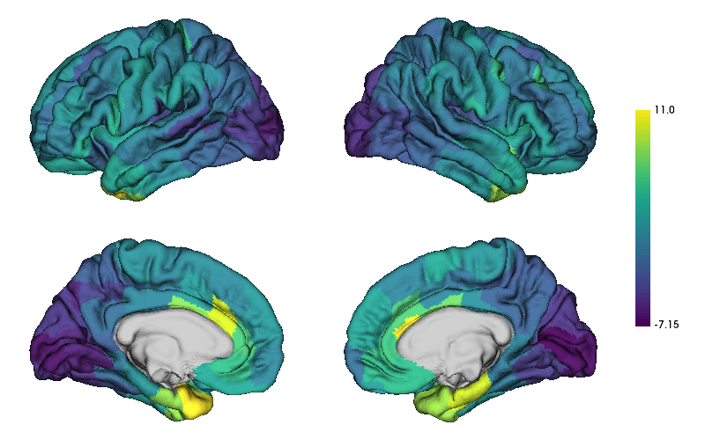
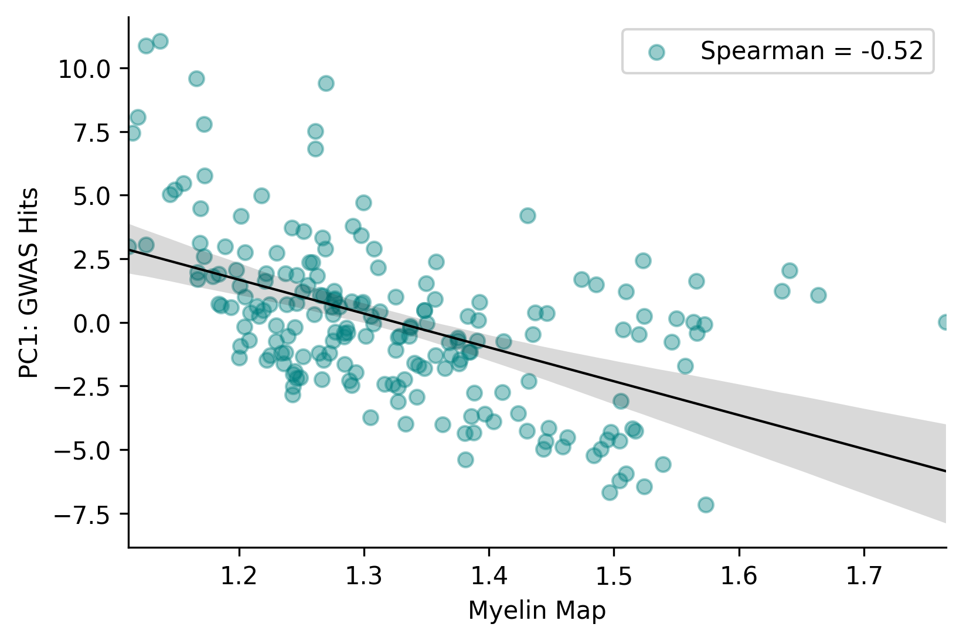
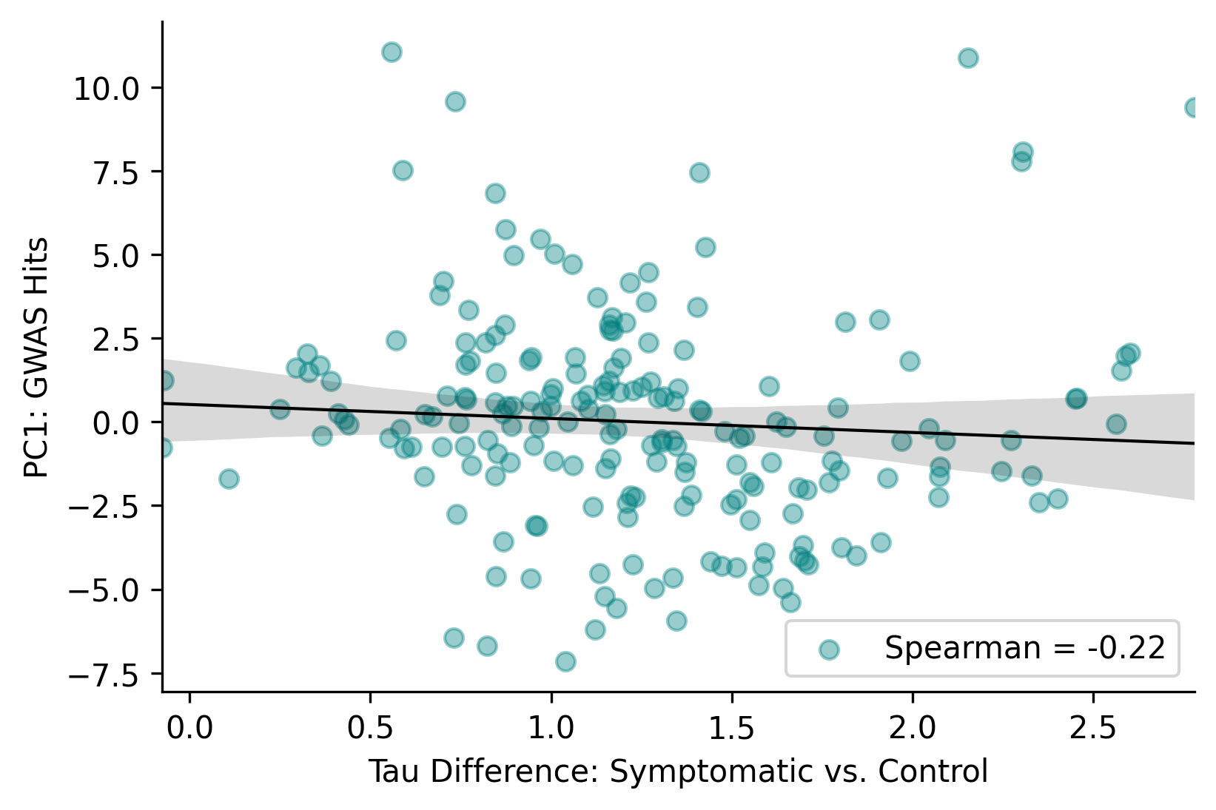



Brain-wide and AD-risk Genetic Expression: A descriptive study
Diana A. Hobbs¹, Austin McCullough¹, Peter Millar¹, and Brian Gordon¹
¹Washington University in St. Louis School of Medicine
There are rules and order to the framework of the brain, and we can explore whether pathology is constrained by these same rules by studying diseased brains.
If pathology is expressed in a measurable pattern, we can better understand and address those disease mechanisms.
Imaging transcriptomics is one such method that can be used to assess biological underpinnings of regional neuroimaging markers and pathology.
Myelin is a well-known neuroimaging marker that captures patterns of genetic expression¹, but little is known about the relationship between specific genetic patterns and tau-containing neurofibrillary tangles characteristic of Alzheimer disease (AD).
AIM: The aim of this study was to assess the relationship between tau deposition and the cortico-spatial representation of the first principal components (PC1) of AD-risk specific genes.
A
C
Background
*
PC1: Entire Microarray
Results & Discussion
Glasser: Myelin Map
*
Tau Difference: Symptomatic vs. Controls
B
D
PC1: AD-Risk Genes
Participants: 443 adults aged 45 to 91 with and without Alzheimer disease. Control (CDR=0, A-): n = 311 (female: n = 170, white: n = 272), mean age: 68$.95 ±$8.23 Symptomatic (CDR $≥$ 1, A+): n = 14 (female: n = 7, white: n = 14), mean age: 74.78 $± 6.98$
Brain-wide genetic expression from the Allen Human Brain Atlas and top prioritized genes from genome-wide significant loci for AD² were parcellated into 200 regions of interest (ROIs) from the Schaefer cortical atlas.
The PC1: Entire Microarray and the PC1: AD-Risk Specific Genes were computed and compared to myelin maps as well as differences in tau-deposition between controls and those symptomatic for AD.
The brain-wide PC1: Entire Microarray was strongly associated with myelin maps (Fig. A: $ρ$ = 0.84, p = 0.01) and unrelated to the difference in tau deposition between those symptomatic for AD and controls (Fig. C: $ρ$= -0.12, p = 0.75).
The PC1: AD-Risk Specific Genes was moderately related to myelin maps (Fig. B: $ρ$ = -0.52, p = 0.02) and unrelated to tau deposition differences between those with AD and those without (Fig. D: $ρ$= -0.22, p = 0.50).
When looking at the genetic cortico-spatial pattern, it is highly reminiscent of myelin – a higher-order structure with well documented patterns of genetic expression. The association becomes weaker when examining AD-risk specific genes tracking myelin.
This is not the case for tau differences between those with AD and those without, and it suggests there are interesting associations that warrant further exploration.
Methods
Contact: dianah@wustl.edu

